Slide 1


European Competencies and Contents of the IT/OT Cybersecurity Specialization Courses
Notes:
n

Slide 2
1. Objective and Scope of the Comparison Document
2. Presentation of Enisa and the European Cybersecurity Competence Framework (ECSF)
2.1. ENISA
2.2. European Cybersecurity Competence Framework (ECSF)
3. Presentation of the Specialization Course in Cybersecurity in Information Technology Environments
4. Presentation of the Specialization Course in Cybersecurity in Operational Technology Environments
5. Analyze the relationship between profiles of the European framework and the professional competences of IT/OT Decrees
5.1. ECSF Analysis & IT Decree
5.1.1. General perspectives
5.1.2. More detailed information
5.1.3. Classification according to alignment
5.1.4. Conclusions
5.2. ECSF Analysis & Decree OT
5.2.1. General perspectives
5.2.2. Detailed information
5.2.3. Classification according to alignment
5.2.4. Conclusions
6. Tables of relationship between profiles and Decree
7. Bibliography
➢ ANNEX I: Complete list of profiles & Decree

Slide 3
1.Objective and Scope of the Comparison Document
Enisa is the European Cybersecurity Agency, and it has defined the roles and profiles of cybersecurity technicians needed to cover the cybersecurity field in companies and organizations. The main objective of this framework is to create a common understanding between individuals, employers, and training program providers in EU Member States.
The European Cybersecurity Skills Framework (ECSF) has defined 12 profiles have been defined along with their titles, missions, tasks, skills, knowledge and competencies that we could group into different groups, some management profiles (CISO) and regulations, risk manager profiles, incidents and threats, technical profiles of architecture design, technical auditing, forensics or pentesting and trainer and researcher profiles
The Tknika cybersecurity group analyzed these profiles and compared them with the existing decrees that regulate cybersecurity specialization courses in the IT and OT fields, comparing the profiles' mission, tasks, skills, and knowledge with the competencies, learning outcomes, and content of the different modules.

Slide 4
2. Presentation of ENISA and the European Cybersecurity Competence Framework (ECSF)
2.1 ENISA
ENISA (European Union Agency for Cybersecurity) is the European Union's cybersecurity agency. It was established in 2004 and is based in Athens and Heraklion, Greece. It is the official body responsible for improving cybersecurity in the European Union . Its main mission is to help Member States, European institutions, and the private sector strengthen their capabilities against cyber threats by promoting a common culture of digital security.
Main tasks of ENISA:
Strategic and technical advice
Risk and policy management
Training and awareness
Support for CSIRTs
Threat research and analysis
Cybersecurity Certification

Slide 5

2.2 European Cybersecurity Competence Framework (ECSF)
The European Cybersecurity Skills Framework ( ECSF ) is an initiative developed by ENISA (the European Union Agency for Cybersecurity) to establish a common language on the roles, skills and knowledge needed in the field of cybersecurity within Europe.
The ECSF is a structured model that defines and classifies cybersecurity professional roles, describing for each:
Its main functions and tasks,
The technical and non-technical skills required,
The associated fundamental knowledge.
It is designed to align educational offerings, labor market needs, and public cybersecurity training policies.

Slide 6
2.2 European Cybersecurity Competence Framework (ECSF)
Objectives of the ECSF:
Establish a common language between companies, educational institutions and public administrations.
Identify and classify professional roles in cybersecurity.
Facilitate the design of training programs and certifications based on the real needs of the sector.
Support career planning for professionals and recruitment for employers.
Bridging the cybersecurity talent gap in Europe.
Who is it for?
Companies and employers: to define job descriptions and recruitment needs.
Trainers and universities: to align educational programs with the labor market.
Professionals: to guide the development of their skills and career.
Politicians and regulators: to create coherent policies on digital skills.

Slide 7
2.2 European Cybersecurity Competence Framework (ECSF)
Contents of the ECSF
The ECSF identifies 12 key professional roles in cybersecurity. Each comes with a detailed description of the duties, required skills, knowledge, and associated tools.
Information Security Officer ( CISO )
Cyber Incident Response
Cyber Legal, Policy & Compliance Officer
Cyber Threat Intelligence Specialist
Cybersecurity Architect
Cybersecurity Auditor
7 . Cybersecurity Educator
8. Cybersecurity Implementer
9. Cybersecurity Researcher
.
10. Cybersecurity Risk Manager
11. Digital Forensics Investigator
12. Penetration Tester .

Slide 8
3. Presentation of the Specialization Course in Cybersecurity in Information Technology Environments
Royal Decree 479/2020, of April 7, establishing the Specialization Course in Cybersecurity in Information Technology Environments and setting out the basic aspects of the curriculum.
DECREE BOPV 83/2023, of June 6, establishing the curricula corresponding to the specialization course in Cybersecurity in Information Technology environments,
Name : Cybersecurity in Information Technology Environments.
Level : Higher Vocational Training.
Duration : 900 hours
Professional Family : Information Technology and Communications (solely for the purposes of classifying Vocational Training courses).
Branch of knowledge : Engineering and Architecture.
ECTS credits : 43.

Slide 9
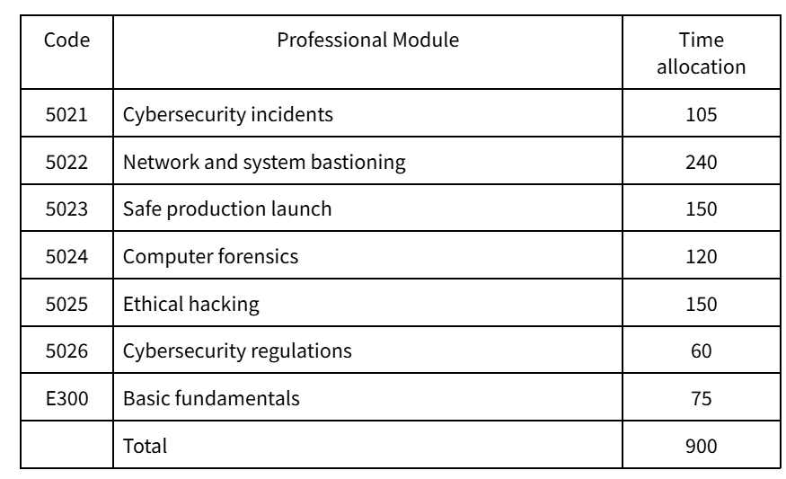
Professional modules.
General competence:
The general competency of this specialization course consists of defining and implementing security strategies in information systems by conducting cybersecurity diagnostics, identifying vulnerabilities, and implementing the necessary measures to mitigate them by applying current regulations and industry standards, following quality, occupational risk prevention, and environmental protection protocols.

Slide 10
4. Presentation of the Specialization Course in Cybersecurity in Operational Technology Environments
Royal Decree 478/2020, of April 7, establishing the Specialization Course in Cybersecurity in Operation Technology Environments
BOVP DECREE 83/2023, of June 6, establishing the curricula for the specialization course in Cybersecurity in Operational Technology Environments
Title : Cybersecurity in Operational Technology Environments. Level : Advanced Vocational Training.
Duration : 900 hours.
Professional Family : Electricity and Electronics (solely for the purposes of classifying Vocational Training courses).
Branch of knowledge : Engineering and Architecture.
ECTS credits : 43.

Slide 11
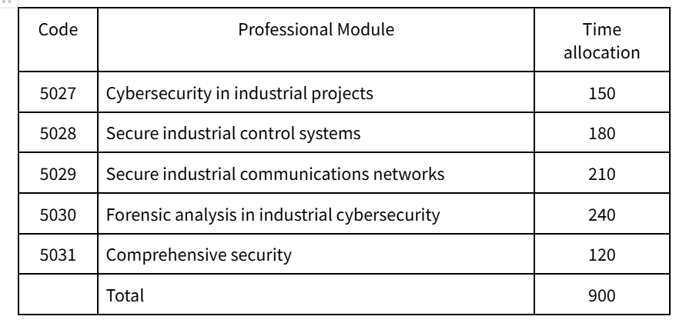
Professional modules.
General competence
The general competency of this specialization course consists of defining and implementing security strategies in organizations and industrial infrastructures by conducting cybersecurity diagnostics, identifying vulnerabilities, and implementing the necessary measures to mitigate them by applying current regulations and industry standards, following quality, occupational risk prevention, and environmental protection protocols.

Slide 12
5. Analyze the relationship between profiles of the European framework and the professional competencies of the IT/OT Decrees
A comparative analysis has been carried out between the European Cybersecurity Competence Framework (ECSF) of ENISA and the curriculum content (Decree) of the Specialization Course in Cybersecurity in Information Technology Environments.
In each profile, the main tasks (Main task) have been related to the learning outcomes (RA) of each module, the key skills (Key Skills) with the personal and social professional competencies, and the key knowledge (Key knowledge) with the contents of each module.
Main Task > Module (RA)
Key skills > Personal and social professional skills
Key knowledge > Modules (Contents)

Slide 13
5.1 ECSF Analysis & IT Decree
5.1.1 General perspective
Following the study carried out—and before going into detail in subsequent sections—we will outline, as a general overview, to what extent we conclude that the ECSF profiles are addressed in our Decree.
ECSF | Main task(s) | Key skill(s) | Key knowledge | Total %
Decree | 55% | 54% | 63% | 58%
As we will see, the profiles with the highest scores are associated with more technical knowledge, while those with lower scores are more closely related to management or teaching roles, which is entirely understandable given the nature of the specialization courses.

Slide 14
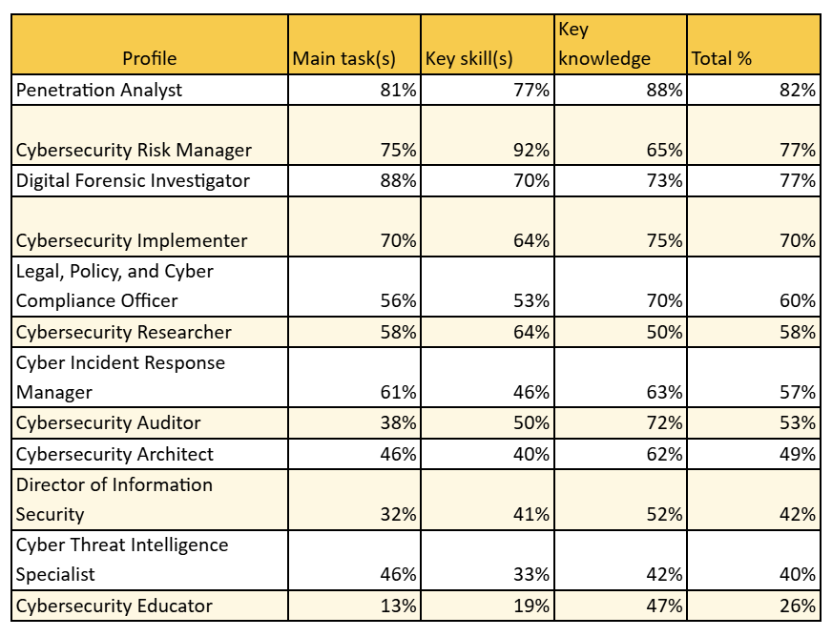
5.1.2 More detailed information
The total score per profile (sum of tasks, skills, and knowledge) allows us to estimate alignment. Higher values indicate a greater alignment of the Decree with the European framework. Below is a table sorted by the percentage of total alignment by profile:
Table sorted by the percentage of total alignment by profile:

Slide 15
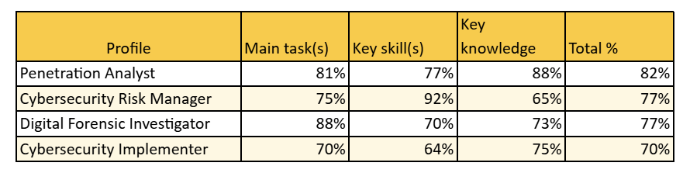
5.1.3 Classification according to alignment
Stronger Alignment: Technical and Practical Functions
The highest match rates are found in profiles focused on those that require greater technical knowledge that can be put into practice in the classroom.

Slide 16
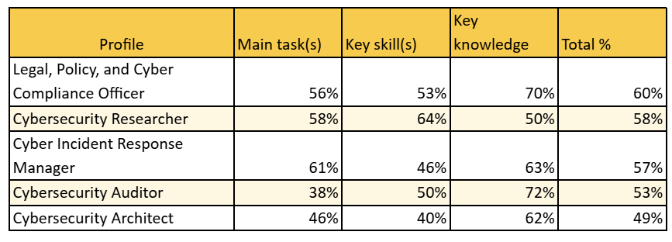
5.1.3 Classification according to alignment
Moderate alignment: strategic and governance-oriented profiles
Several profiles show moderate levels of alignment; these profiles have been able to be addressed in detail in the classroom, but are more difficult to address in simulated environments like those used in the classroom.

Slide 17
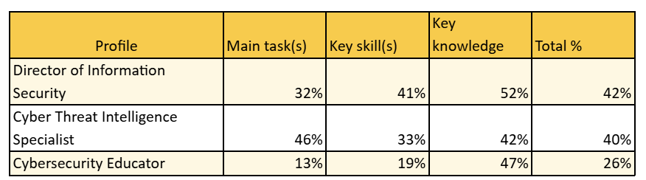
5.1.3 Classification according to alignment
Bottom lineup: specialized or management profiles
As expected, the more specific profiles, those with a greater management component or those related to strategic outreach, have a lower level of alignment.

Slide 18
    Conclusions
5.1.4 Conclusions
The data show that the Decree covers more than 50% of the details of the profiles defined by the ECSF in general. In detail, four profiles are strongly aligned (70% or more), five are moderately aligned (45% or more), and three are weakly aligned (less than 45%). Furthermore, of the 12 profiles, eight are aligned above 50%, and three are aligned above 75%.
We believe that, for a full-length specialization course, the data demonstrates that the curriculum is highly tailored and aligned with key technical functions in European cybersecurity.

Slide 19
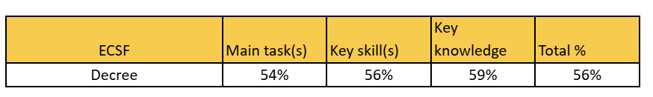
5.2 ECSF Analysis & OT Decree
5.2.1 General perspective
Following the study carried out—and before going into detail in subsequent sections—we will outline, as a general overview, to what extent we conclude that the ECSF profiles are addressed in our Decree.
The data show varying levels of alignment between professional profiles and the needs of the OT environment. Functions with higher combined scores indicate stronger alignment with technical operations, while others stand out for their strategic components or thematic specialization.

Slide 20
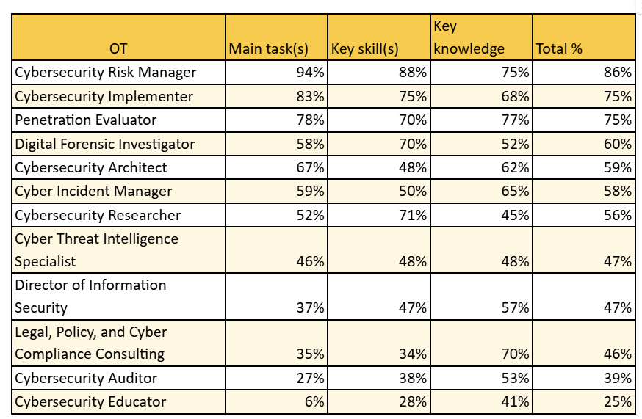
5.2.2 More detailed information
The total score by role (sum of tasks, skills, and knowledge) allows us to estimate alignment. Higher values indicate greater fit with the OT field, both technically and functionally. The total by role is shown below, sorted in descending order:

Slide 21
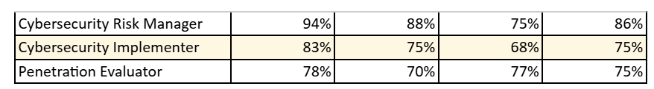
5.2.3 Classification according to alignment
Stronger Alignment: Technical and Practical Functions
The highest match rates are found in profiles focused on those that require greater technical knowledge that can be put into practice in the classroom.

Slide 22
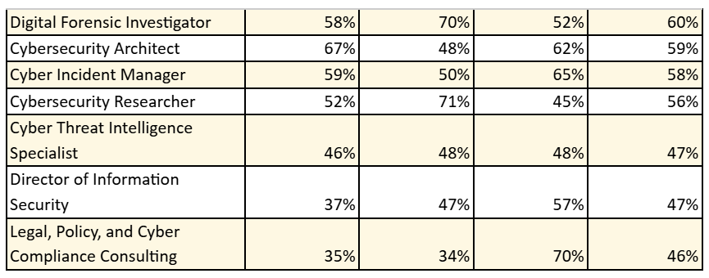
5.2.3 Classification according to alignment
Moderate alignment: strategic and governance-oriented profiles
Several profiles show moderate levels of alignment; these profiles have been able to be addressed in detail in the classroom, but are more difficult to address in simulated environments like those used in the classroom.

Slide 23

5.2.3 Classification according to alignment
Bottom lineup: specialized or management profiles
As expected, the more specific profiles, those with a greater management component or those related to strategic outreach, have a lower level of alignment.

Slide 24
    Conclusions
5.2.4 Conclusions
The data show that the Decree covers more than 50% of the details of the profiles defined by the ECSF in general. In detail, three profiles are strongly aligned (70% or more), seven are moderately aligned (45% or more), and two are weakly aligned (less than 45%). Furthermore, of the 12 profiles, seven exceed 50% alignment, and three exceed 75%.
Most of the roles analyzed show good alignment with OT requirements, especially those focused on technical implementation, security architecture, and incident response. Mixed profiles between technical and political management would fall somewhere in between, while profiles focused on education, policy, or forensic analysis have a more limited contribution, although relevant in specific contexts.
This difference in IT values is logical given the different nature of the facilities. In the OT area, architecture, incident management, and risk management take priority, given that it's a production facility. Management and auditing are secondary.
We believe that, for a full-length specialization course, the data demonstrates that the curriculum is highly tailored and aligned with key technical functions in European cybersecurity.

Slide 25
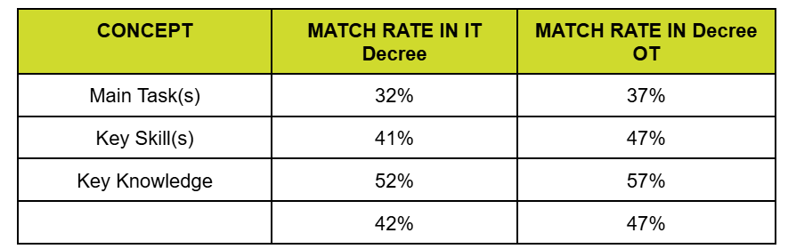
6. TABLES OF RELATIONSHIP BETWEEN PROFILES AND DECREES
CHIEF INFORMATION SECURITY OFFICER (CISO)

Slide 26
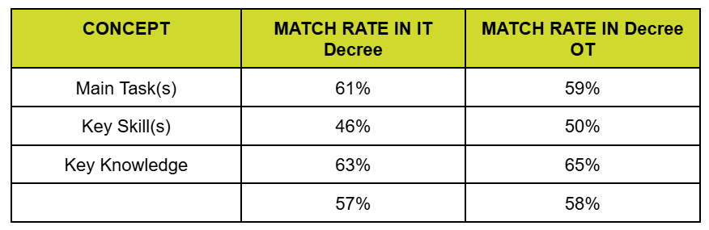
6. TABLES OF RELATIONSHIP BETWEEN PROFILES AND DECREES
CYBER INCIDENT RESPONDER

Slide 27
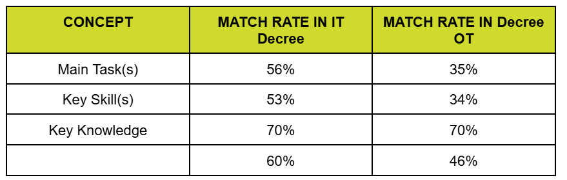
6. TABLES OF RELATIONSHIP BETWEEN PROFILES AND DECREES
CYBER LEGAL, POLICY & COMPLIANCE OFFICER

Slide 28
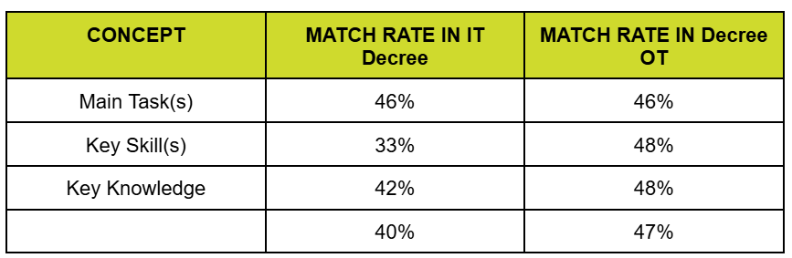
6. TABLES OF RELATIONSHIP BETWEEN PROFILES AND DECREES
CYBER THREAT INTELLIGENCE SPECIALIST

Slide 29
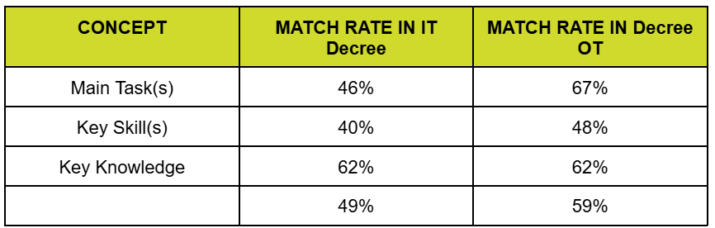
6. TABLES OF RELATIONSHIP BETWEEN PROFILES AND DECREES
CYBERSECURITY ARCHITECT

Slide 30
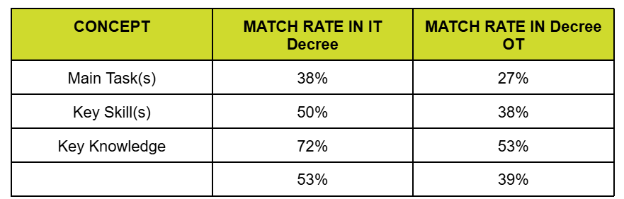
6. TABLES OF RELATIONSHIP BETWEEN PROFILES AND DECREES
CYBERSECURITY AUDITOR

Slide 31
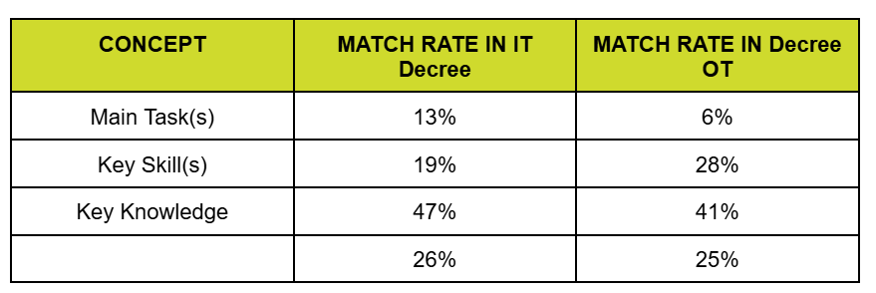
6. TABLES OF RELATIONSHIP BETWEEN PROFILES AND DECREES
CYBERSECURITY EDUCATOR

Slide 32
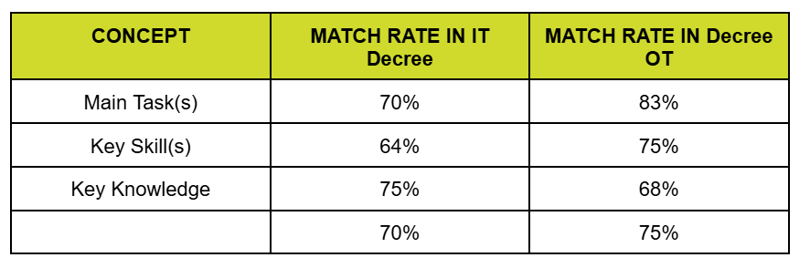
6. TABLES OF RELATIONSHIP BETWEEN PROFILES AND DECREES
CYBERSECURITY IMPLEMENTER

Slide 33
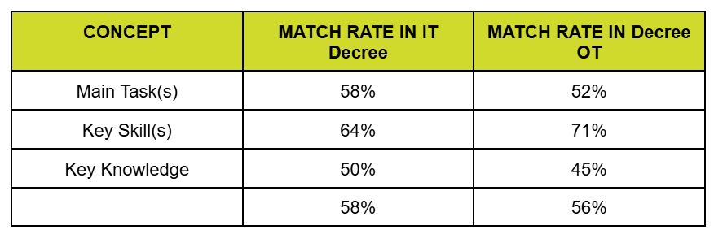
6. TABLES OF RELATIONSHIP BETWEEN PROFILES AND DECREES
CYBERSECURITY RESEARCHER

Slide 34
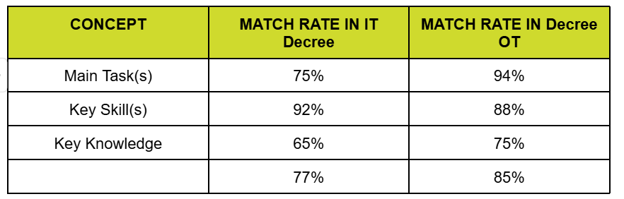
6. TABLES OF RELATIONSHIP BETWEEN PROFILES AND DECREES
CYBERSECURITY RISK MANAGER

Slide 35
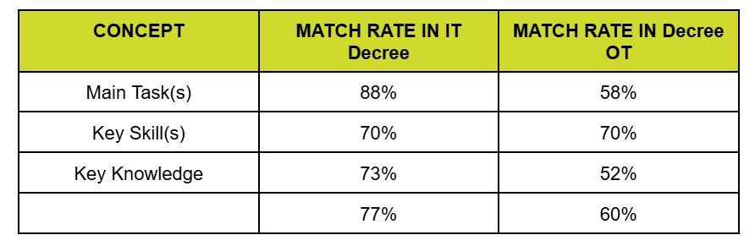
6. TABLES OF RELATIONSHIP BETWEEN PROFILES AND DECREES
DIGITAL FORENSICS INVESTIGATOR

Slide 36
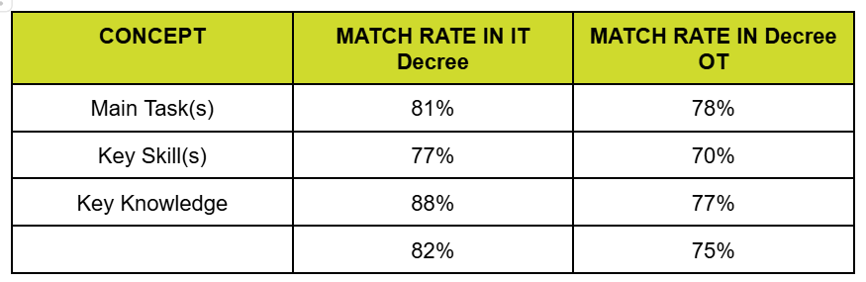
6. TABLES OF RELATIONSHIP BETWEEN PROFILES AND DECREES
PENETRATION TESTER

Slide 37
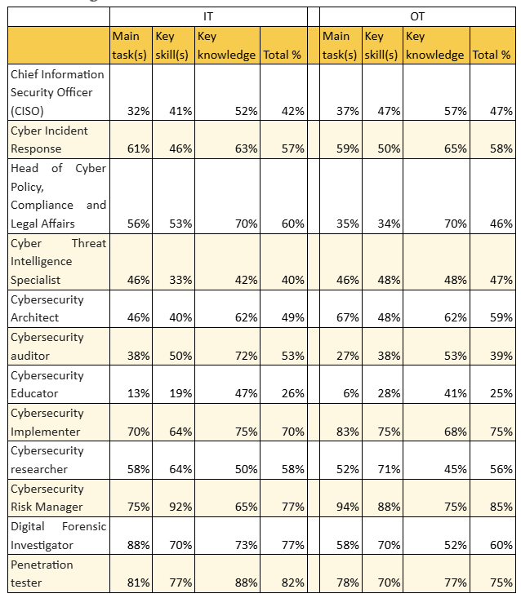
6. TABLES OF RELATIONSHIP BETWEEN PROFILES AND DECREES
Summary table

Slide 38
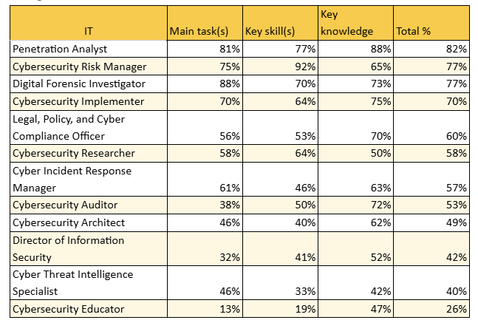
6. TABLES OF RELATIONSHIP BETWEEN PROFILES AND DECREES
Profiles (ECSF) % IT

Slide 39
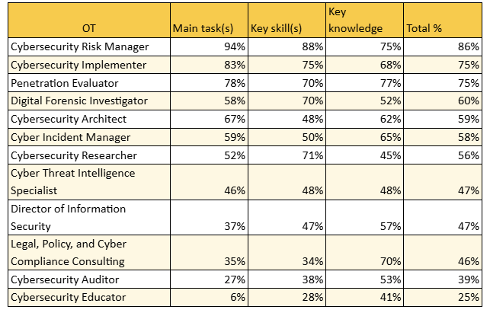
6. TABLES OF RELATIONSHIP BETWEEN PROFILES AND DECREES
Profiles (ECSF) % OT

Slide 40
7. LITERATURE
Enisa : https://www.enisa.europa.eu/
The European Cybersecurity Competence Framework (ECSF)
https://www.enisa.europa.eu/publications/european-cybersecurity-skills-framework-ecsf
Basque Institute of Vocational Training Knowledge IVAC EEI
https://ivac-eei.eus/es/
COURSE IN CYBERSECURITY IN INFORMATION TECHNOLOGY ENVIRONMENTS
https://ivac-eei.eus/es/familias-profesionales/informatica-y-comunicaciones-ifc/especializaciones/curso-de-especializacion-en-ciberseguridad-en-entornos-de-las-tecnologias-de-la-informacion.html
COURSE IN CYBERSECURITY IN OPERATIONAL TECHNOLOGY ENVIRONMENTS
https://ivac-eei.eus/es/familias-profesionales/electricidad-y-electronica-ele/especializaciones/curso-de-especializacion-en-ciberseguridad-en-entornos-de-las-tecnologias-de-operacion.html

Slide 41
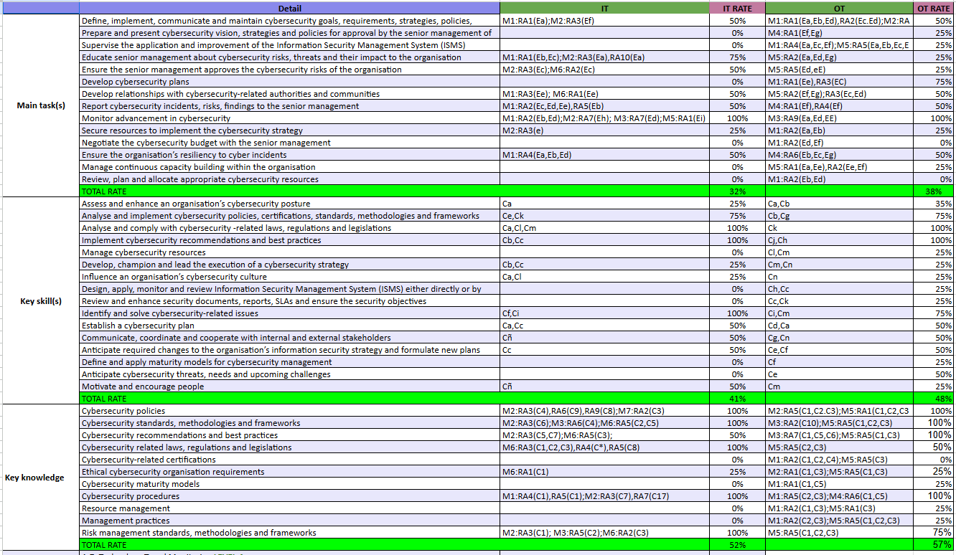
7. ANNEX 1 Complete list of profiles & Decree
1-Chief Information Security Officer
The level of compliance (RATE) has been quantified in the decree of each "Detail" of the ECSF taking into account the following scale: 0% - 25% - 50% - 75% - 100 %

Slide 42
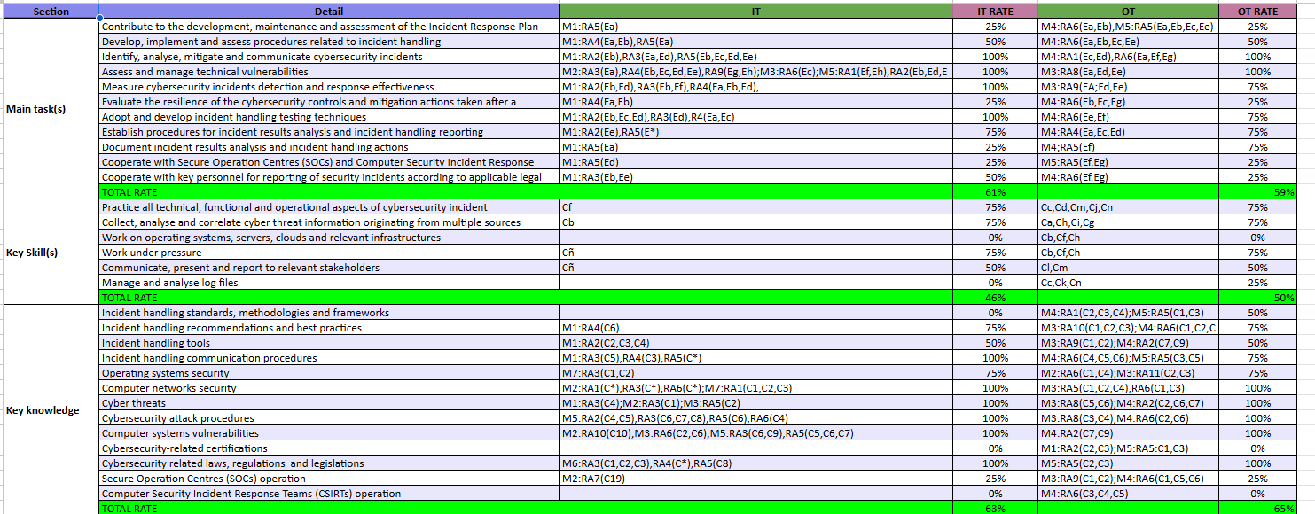
7. ANNEX 1 Complete list of profiles & Decree
2- Cyber Incident Responder
The level of compliance (RATE) has been quantified in the decree of each "Detail" of the ECSF taking into account the following scale: 0% - 25% - 50% - 75% - 100 %

Slide 43
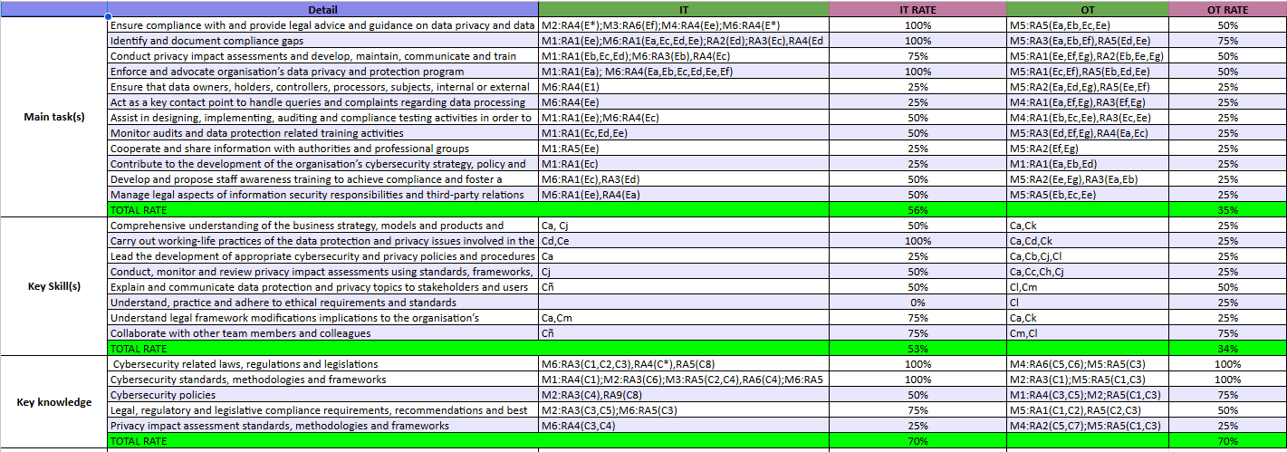
7. ANNEX 1 Complete list of profiles & Decree
3-Cyber Legal, Policy & Compliance Officer
The level of compliance (RATE) has been quantified in the decree of each "Detail" of the ECSF taking into account the following scale: 0% - 25% - 50% - 75% - 100 %

Slide 44
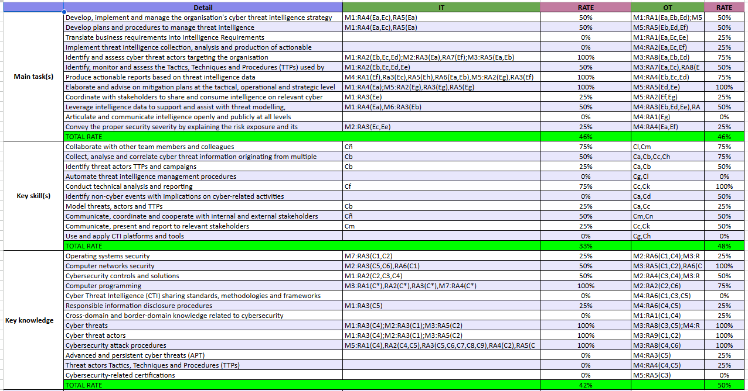
7. ANNEX 1 Complete list of profiles & Decree
4- Cyber Threat Intelligence
Specialist
The level of compliance (RATE) has been quantified in the decree of each "Detail" of the ECSF taking into account the following scale: 0% - 25% - 50% - 75% - 100 %

Slide 45
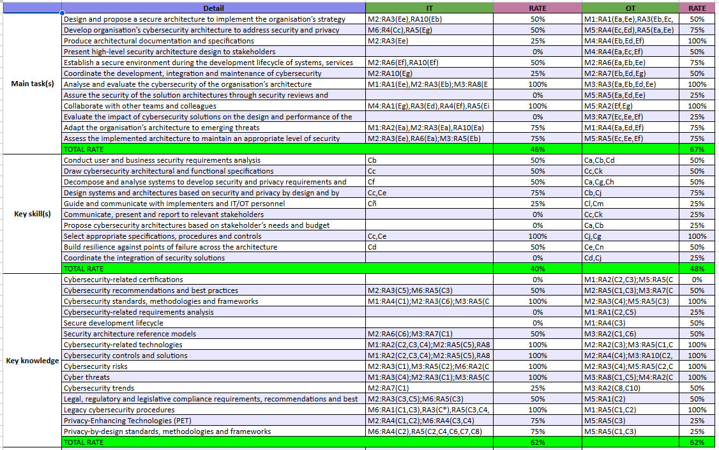
7. ANNEX 1 Complete list of profiles & Decree
5- Cybersecurity Architect
The level of compliance (RATE) has been quantified in the decree of each "Detail" of the ECSF taking into account the following scale: 0% - 25% - 50% - 75% - 100 %

Slide 46
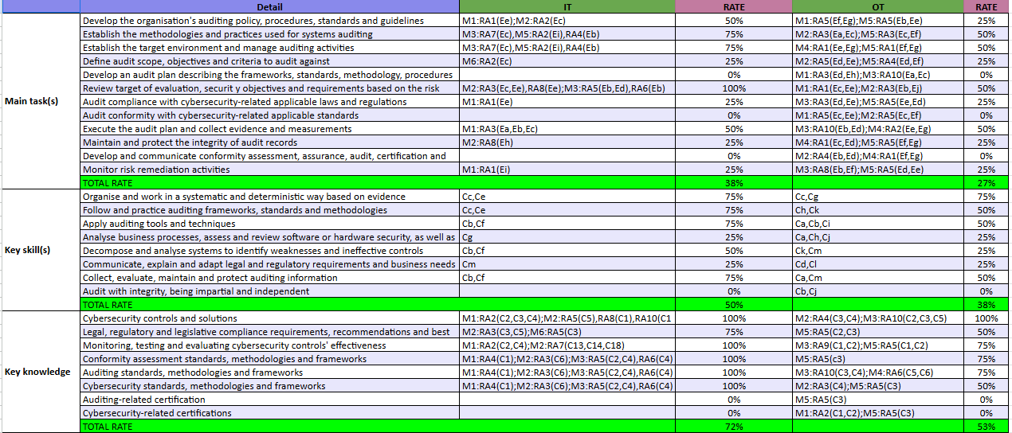
7. ANNEX 1 Complete list of profiles & Decree
6- Cybersecurity Auditor
The level of compliance (RATE) has been quantified in the decree of each "Detail" of the ECSF taking into account the following scale: 0% - 25% - 50% - 75% - 100 %

Slide 47
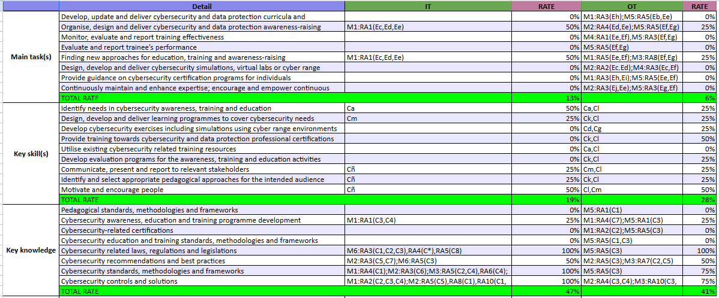
7. ANNEX 1 Complete list of profiles & Decree
7- Cybersecurity Educator
The level of compliance (RATE) has been quantified in the decree of each "Detail" of the ECSF taking into account the following scale: 0% - 25% - 50% - 75% - 100 %

Slide 48
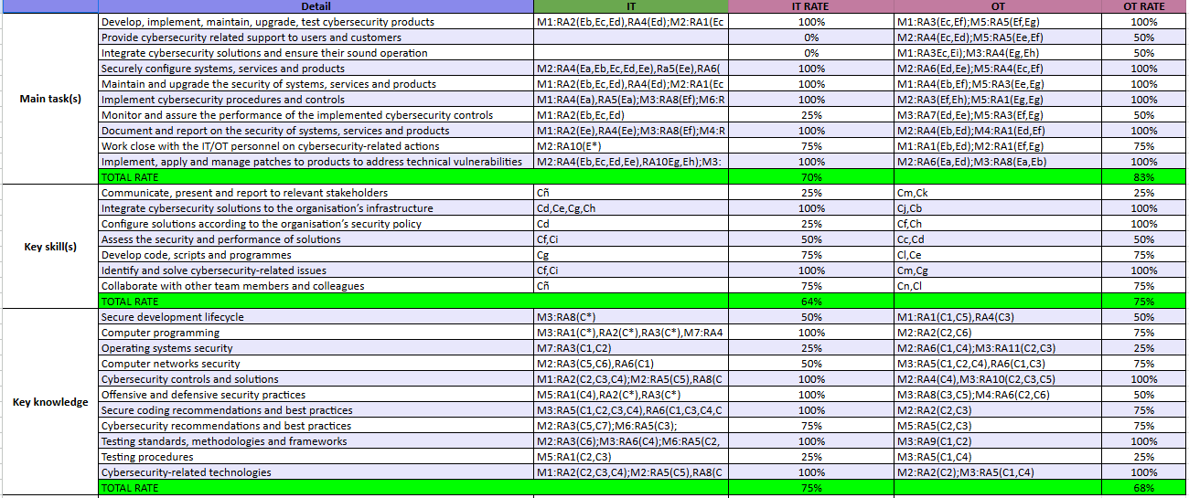
7. ANNEX 1 Complete list of profiles & Decree
8- Cybersecurity Implementer
The level of compliance (RATE) has been quantified in the decree of each "Detail" of the ECSF taking into account the following scale: 0% - 25% - 50% - 75% - 100 %

Slide 49
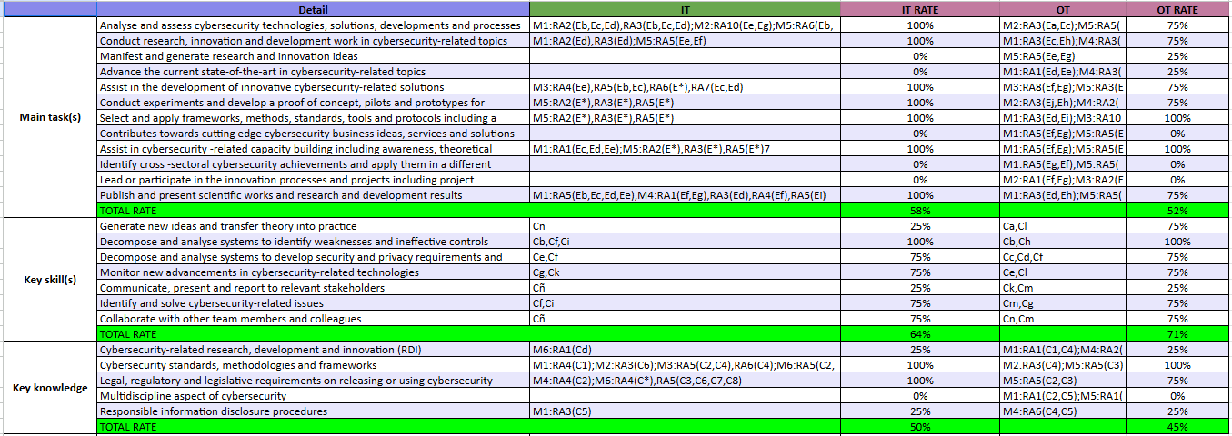
7. ANNEX 1 Complete list of profiles & Decree
9- Cybersecurity Researcher
The level of compliance (RATE) has been quantified in the decree of each "Detail" of the ECSF taking into account the following scale: 0% - 25% - 50% - 75% - 100 %

Slide 50
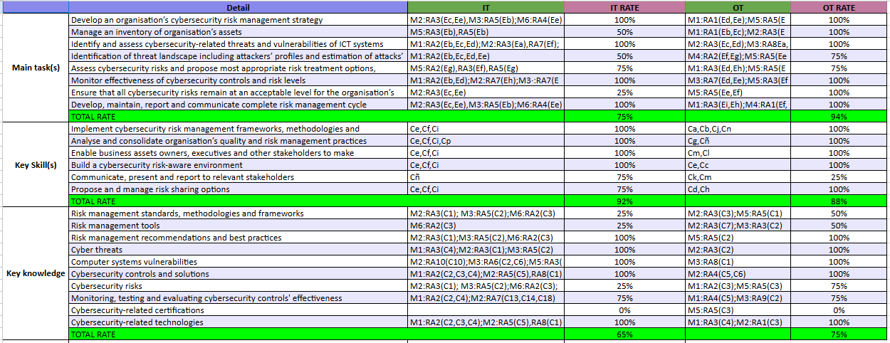
7. ANNEX 1 Complete list of profiles & Decree
10- Cybersecurity Risk Manager
The level of compliance (RATE) has been quantified in the decree of each "Detail" of the ECSF taking into account the following scale: 0% - 25% - 50% - 75% - 100 %

Slide 51
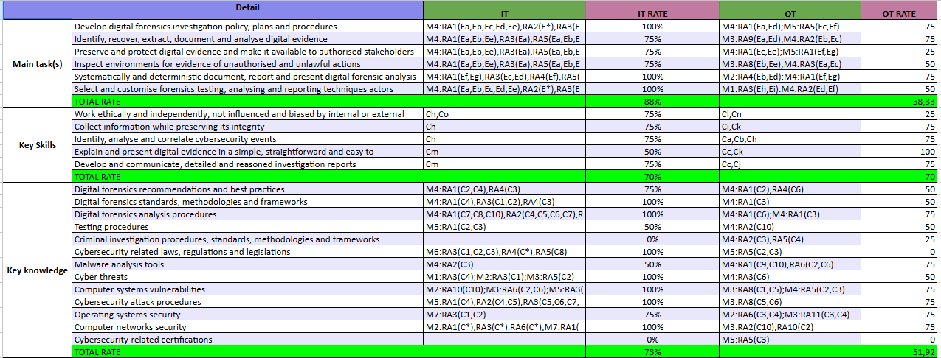
7. ANNEX 1 Complete list of profiles & Decree
11- Digital Forensics Investigator
The level of compliance (RATE) has been quantified in the decree of each "Detail" of the ECSF taking into account the following scale: 0% - 25% - 50% - 75% - 100 %

Slide 52
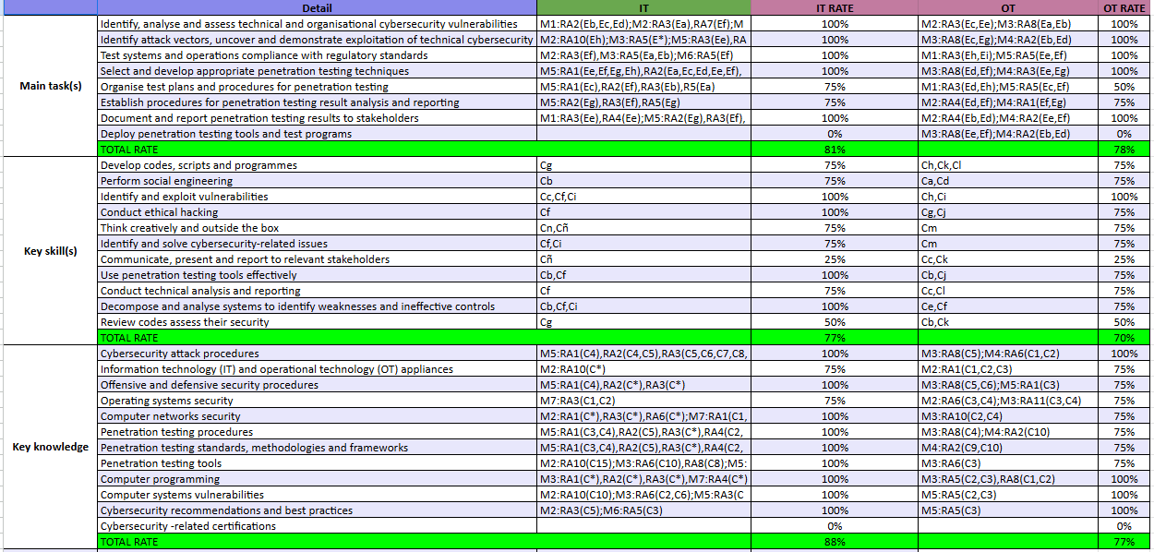
7. ANNEX 1 Complete list of profiles & Decree
12- Penetration Test
The level of compliance (RATE) has been quantified in the decree of each "Detail" of the ECSF taking into account the following scale: 0% - 25% - 50% - 75% - 100 %

Slide 53

European Competencies and Contents of the IT/OT Cybersecurity Specialization Courses
Notes:
n

